Slide 1

Topics
•
Interfaces
in
Java
1
Object-Oriented Programming Using Java

Slide 2
Interfaces in Java
•
Java does not support Multiple-Inheritance directly. Multiple inheritance can be
achieved in java by the use of Interfaces.
We need interfaces when we want functionality to be included but does not want to impose implementation.
Implementation issue is left to the individual classes implementing the interfaces.
Interfaces can have only abstract methods and final fields.
Every method in an interface is by default public abstract
Every variable in an interface is by default public final
You can declare a variable to be of type interface. But you can not create an object belonging to type interface.
Interface variable can point to objects of any class implementing the interface. Another way of implementing Run Time Polymorphism.
•
•
•
•
•
•
•
•
2
Object-Oriented Programming Using Java

Slide 3
Class vs Interfaces
(Similarities)
•
•
is compiled into byte code file
can be either public, protected, private or package accessibility
can not be public unless defined in the file having same
•
name
serve
as
as
interface name
•
a
type
for
declaring
variables
and
parameters
3
Object-Oriented Programming Using Java

Slide 4
Class vs Interfaces
(Differences)
•
•
Declares only Method Headers and public constants
Has no constructors [So, an object never belongs to an interface].
•
Can be implemented by a class. A class
multiple interfaces.
can
implement
•
•
Can
Can
not extend a class.
extend
several
other
interfaces.
4
Object-Oriented Programming Using Java

Slide 5
Interface Syntax : General Form
•
Syntax :
<scope> interface <interface-name> extends [ <interface1>
{
,… ,<interface-N>]
[public][final]
<type> variable-name-1 = value;
.
.
<type> variable-name-N = value;
[public][final]
[public][abstract]
<return
type>
method-name-1(<parameter
.
.
lis>);
[public][abstract]
<return
type>
method-name-N(<parameter lis>);
}
5
Object-Oriented Programming Using Java

Slide 6
Interface Example
1
public interface A
{
double PI = 3.14156;
void show();
void display();
Name
of source file must be A.java
public final PI = 3.1456;
public abstract void show();
public abstract void display();
} // End of Interface
A
class
{
X
implements
A
public
public
void show() { }
void display() {
Implemented Methods of
Interfaces should have public scope
}
}// End of class X
6
Object-Oriented Programming Using Java

Slide 7
Interface Example
2
public interface A
{
double PI = 3.14156;
void show();
void display();
} // End of Interface
A
A
class
should
either
fully
or it as
abstract class
{
public void
}
X
implements
A
implement an
interface
declared
show() { }
should
abstract
be
class
{
Y
extends
X
public void display() {
}// End of class X
}
7
Object-Oriented Programming Using Java

Slide 8
Interface
Example
3
interface A
{
void show-1();
void display-1();
} // End of Interface A
interface B
{
void show-2();
void display-2();
} // End of Interface B
interface C extends A, B
{
void show-3();
void display-3();
An interface can extend
multiple interfaces
class
{
X
implements
C
void
void void void void void
show-1()
display-1() show-2() display-2() show-3() display-3()
{ }
{ }
{
{
{
{
}
}
}
}
}
// End
of class X
If a
class implements
a sub-interface
then it also implements its super
interfaces
}
// End of Interface C
8
Object-Oriented Programming Using Java

Slide 9
Interface
Example
4
interface Area
{
double
<<Interface>>
Area
PI = 3.1456;
double area();
double perimeter();
} // End of Interface Area
interface Volume extends Area
{
double volume();
} // End of Interface Volume
Volume
<<Interface>>
9
Object-Oriented Programming Using Java

Slide 10
Interface Example
4
….
class
{
Circle implements Area
private double radius;
Circle(double radius)
{
this.radius = radius;
}
double getRadius() { return radius;}
public
{
double
area()
return
PI * radius * radius;
}
public
{
double
perimeter()
return
2 * PI * radius;
}
End of class
}//
10
Circle
Object-Oriented Programming Using Java

Slide 11
Interface Example
4
….
class
{
BOX implements Volume
public double volume()
{
return length * width * height ;
} // End of Method
private double length;
private double width; private double height; BOX(double l, double
{
length = l; width = b; height = h;
}
public
{
double perimeter()
b, double
h)
double p = length+width+height;
return 4 * p; End of Method
}//
} // End of class BOX
double
double double public
{
getLength() {
return length ;}
getWidth() { return width ;}
getHeight() { return height ;}
double area()
return 2 * (length * width + width * height + height * length);
} // End of Method
11
Object-Oriented Programming Using Java

Slide 12
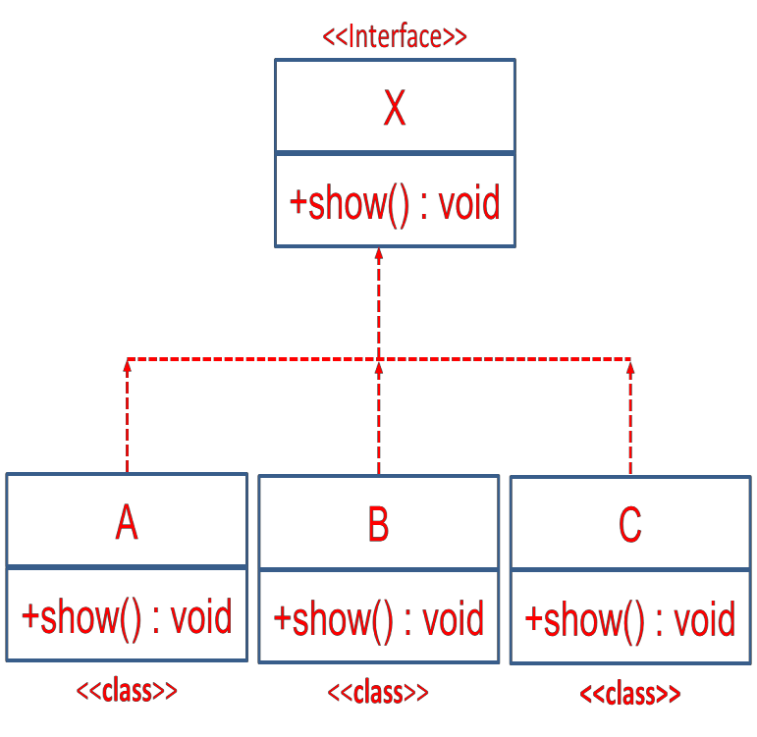
Runtime Polymorphism
Through Interfaces
•
Suppose ‘X’ is an interface and three concrete
‘B’, and ‘C’ implements ‘X’ interface
classes
namely
‘A’,
Any Interface Type Variable Can Point
to Any Instance of a Class That
Implements
the Interface
X
x1 =
new A();
x1.show();
Invokes show()
of class A
x1
=
new B();
x1.show();
Invokes show()
of class B
12
Object-Oriented Programming Using Java

Slide 13
Thank
You
13
Object-Oriented Programming Using Java

